Slide 1
Music Genre Classification
Namita Anandaram, Ivan Palalia, Ronald Ho, Michael Trias

Slide 2
Outline
Data set from GTZAN
Using Librosa to extract features from the Audio files
Audio -> Spectrogram -> Feature data
Uploading into Amazon AWS for Colab connection
Using Colab to Test and Train Data
Random Forest
KNN
Kmean (unsupervised learning)
Conclusion

Slide 3
Data
GTZAN dataset
The dataset consists of 1000 audio tracks each 30 seconds long.
The 10 genres are:
Blues
Classical
Country
Rock
Disco
Reggae
Hip-hop
Jazz
Metal
Pop

Slide 4
WHAT WE USED TO DO MACHINE LEARNING
Technologies Used:
Libraries used:
Pandas
Amazon AWS
Google Colab
Python
Matplotlib
Sklearn Library
Librosa
Ensemble

Slide 5
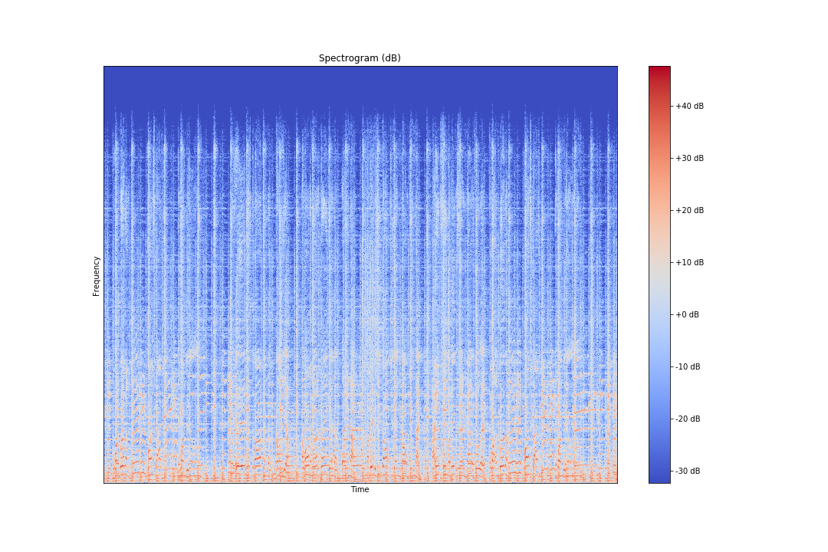
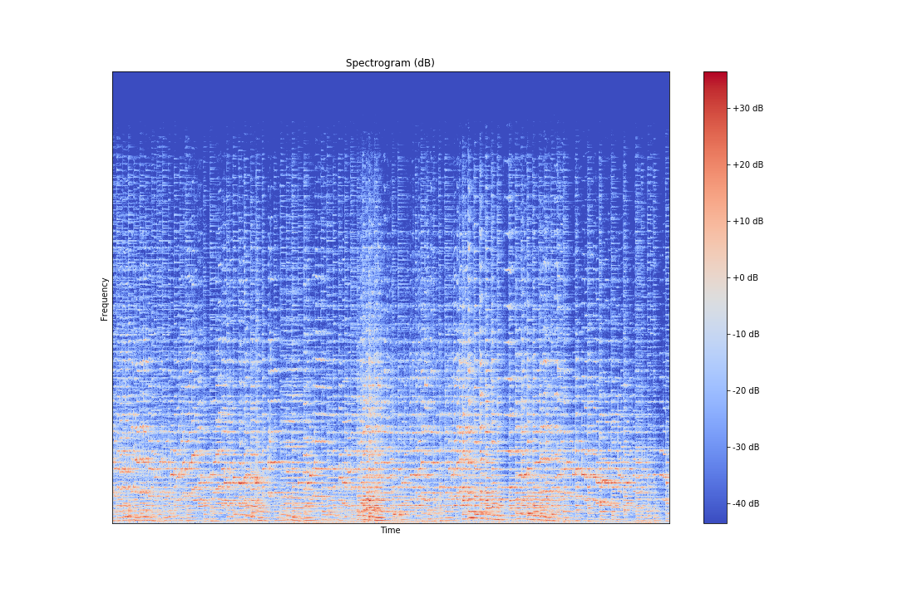
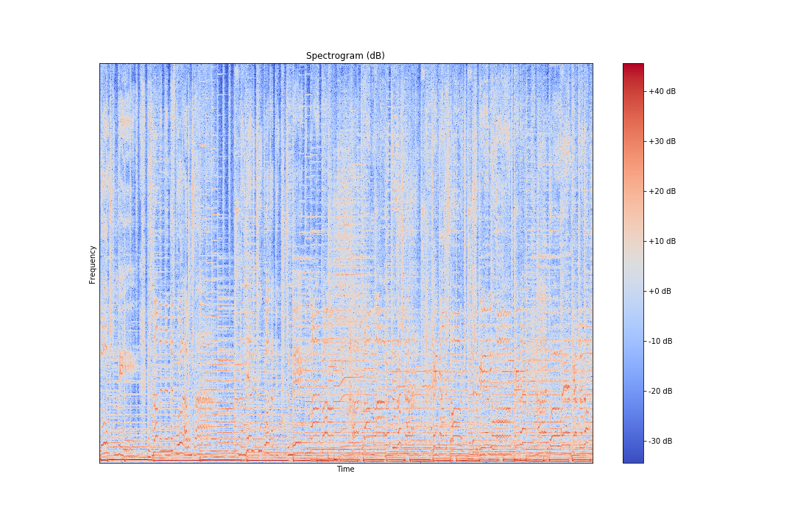
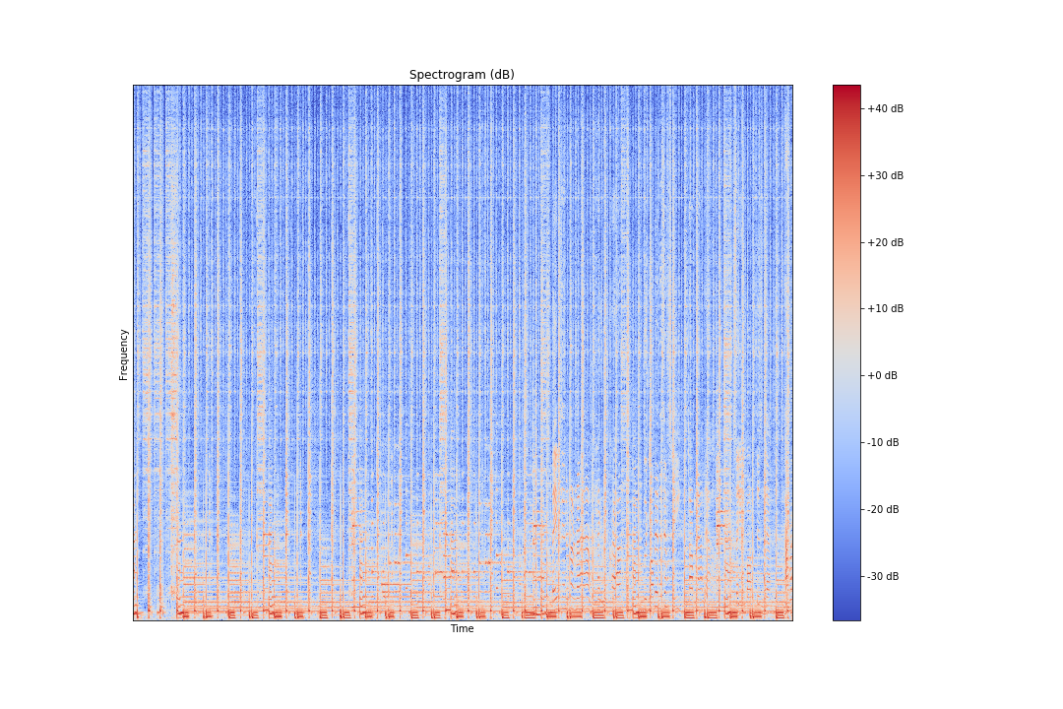
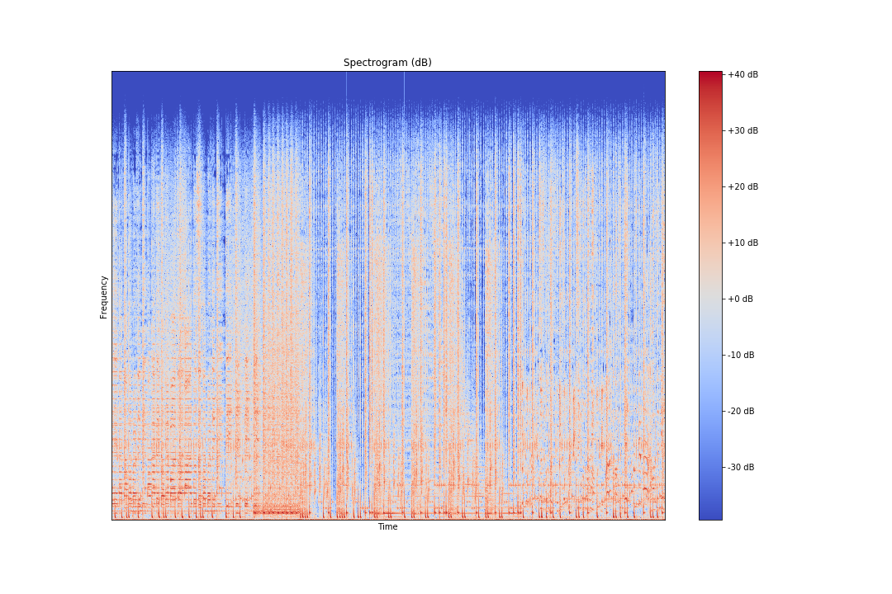
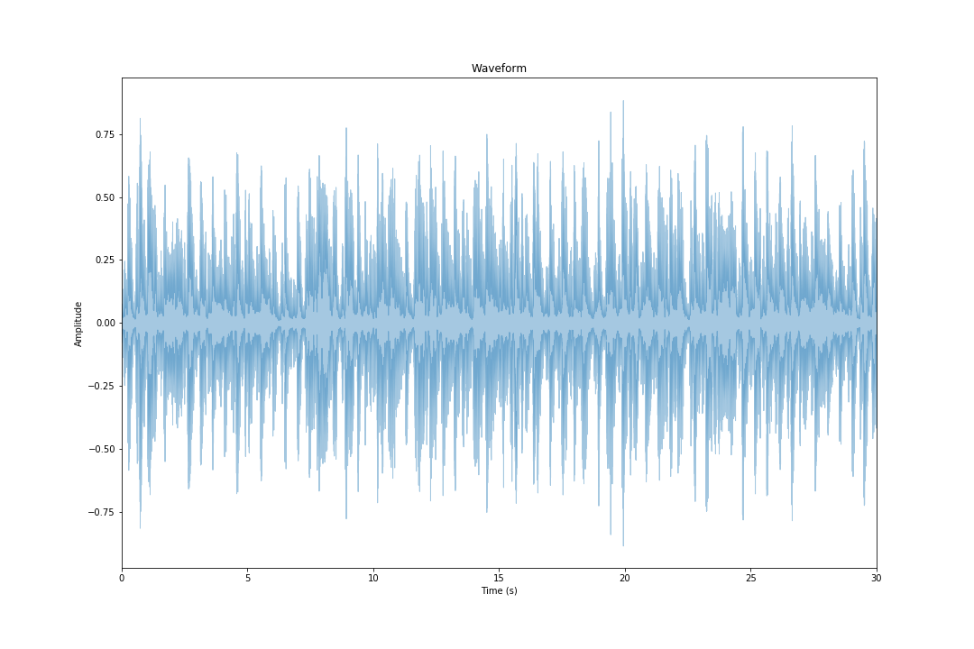
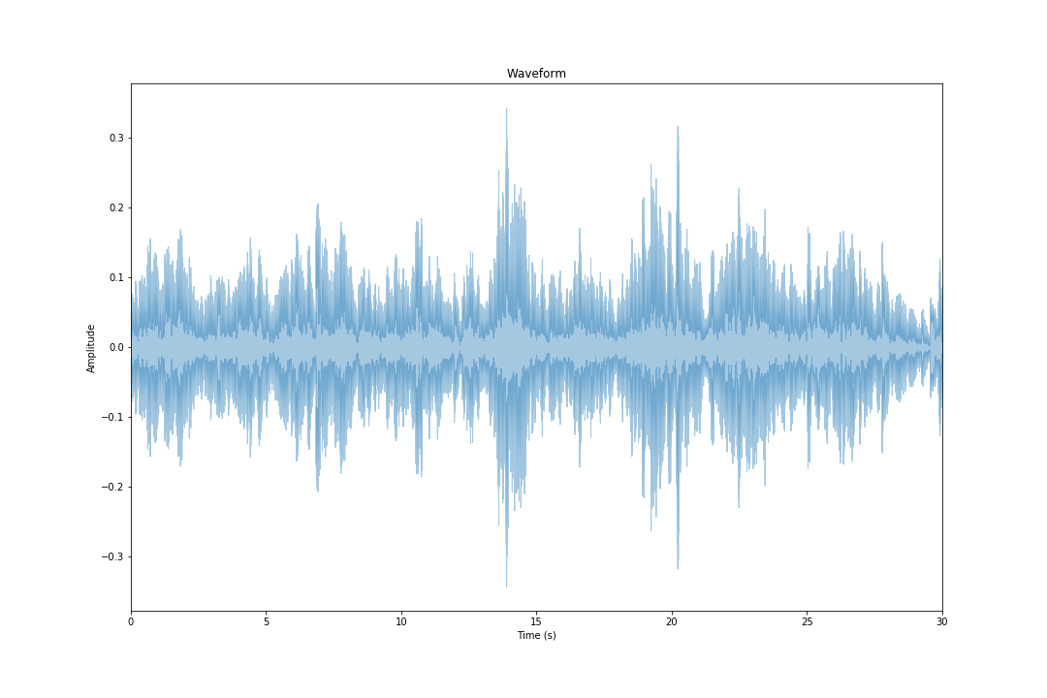
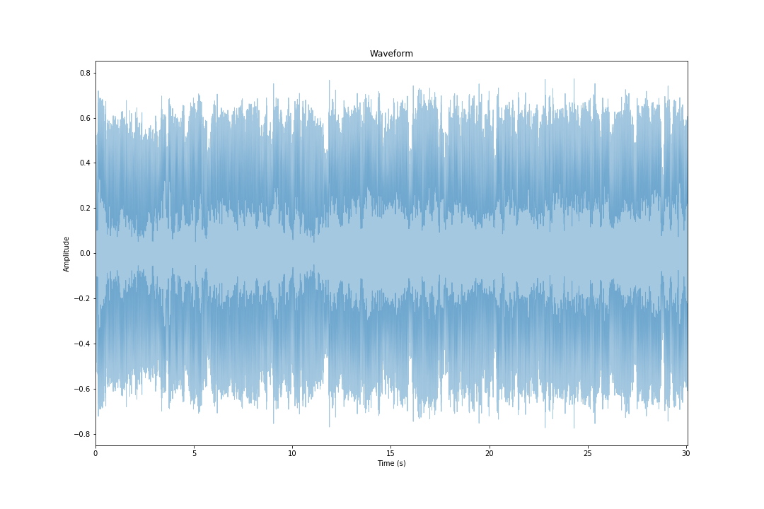
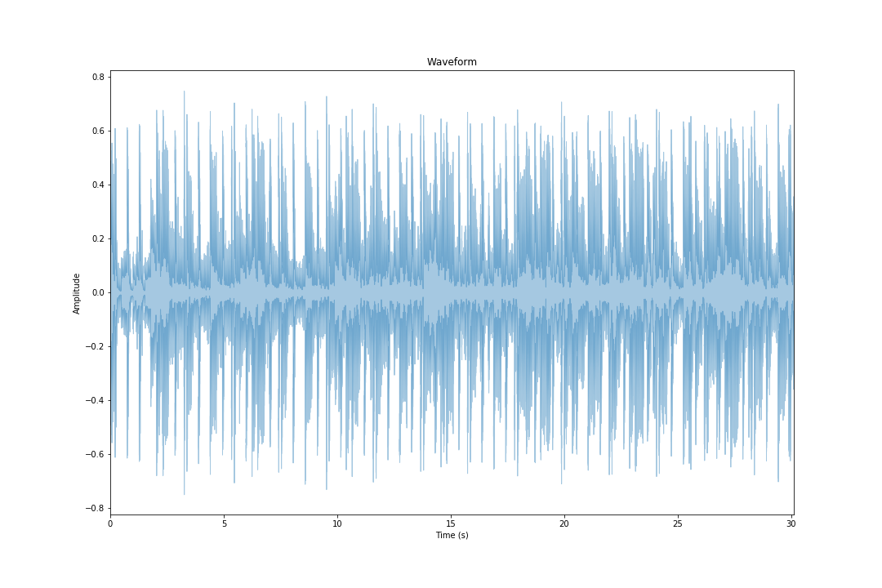
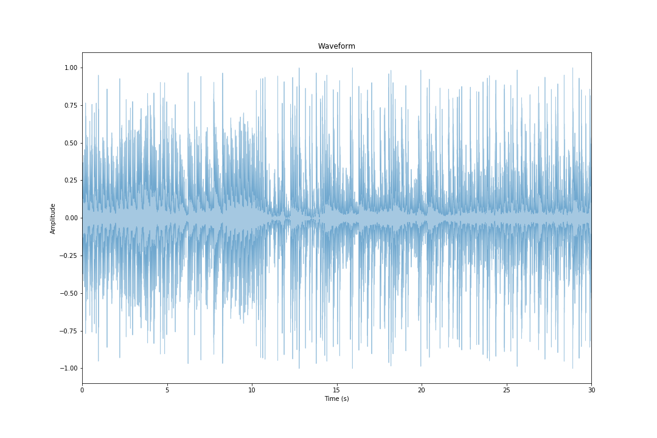
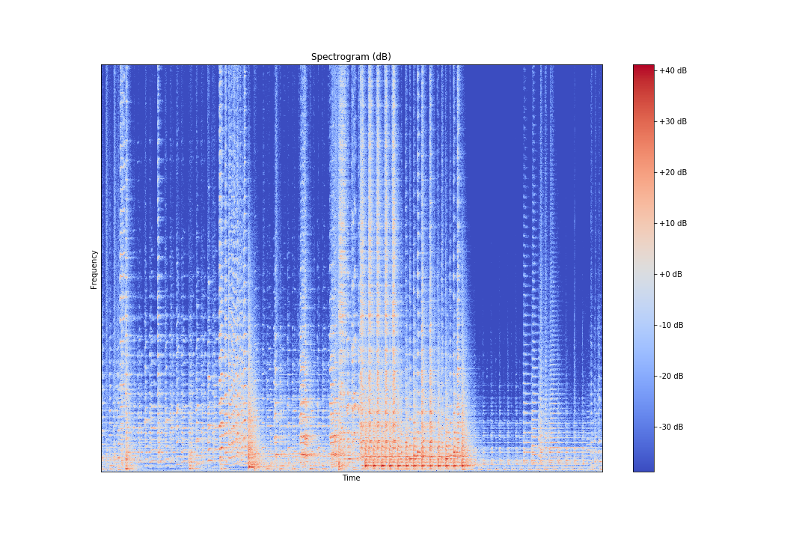
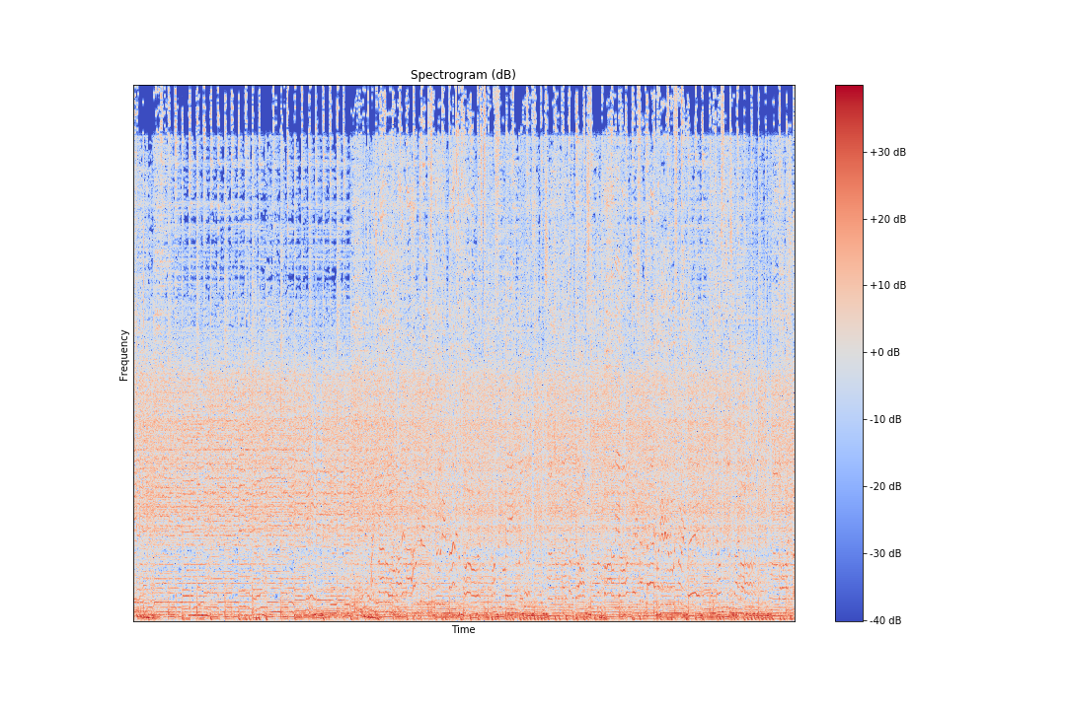
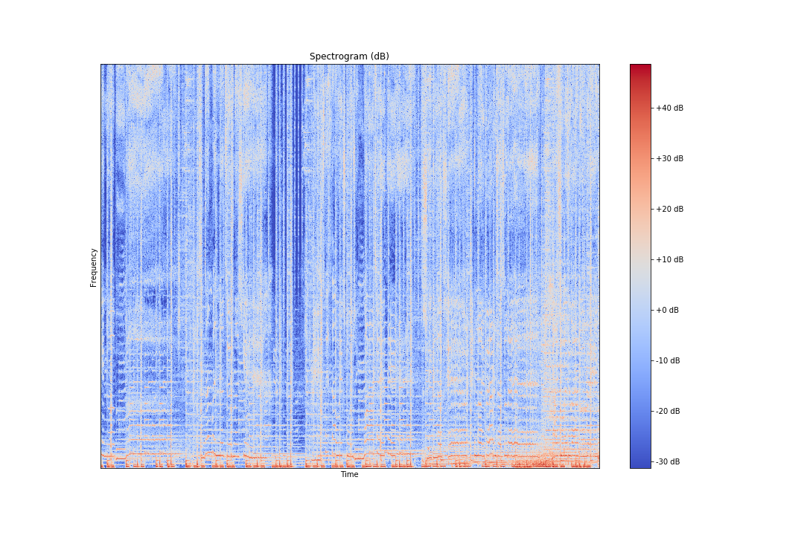
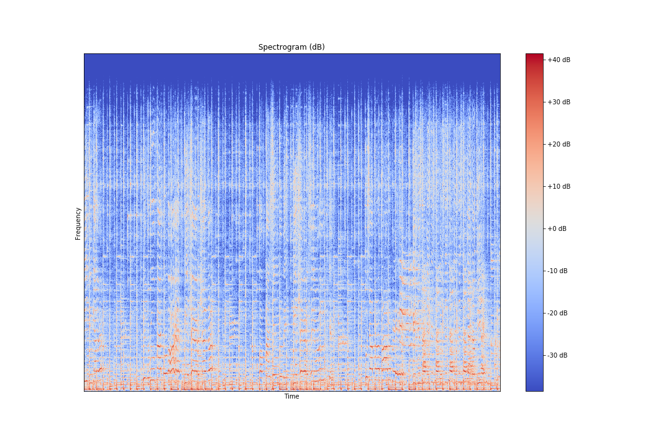
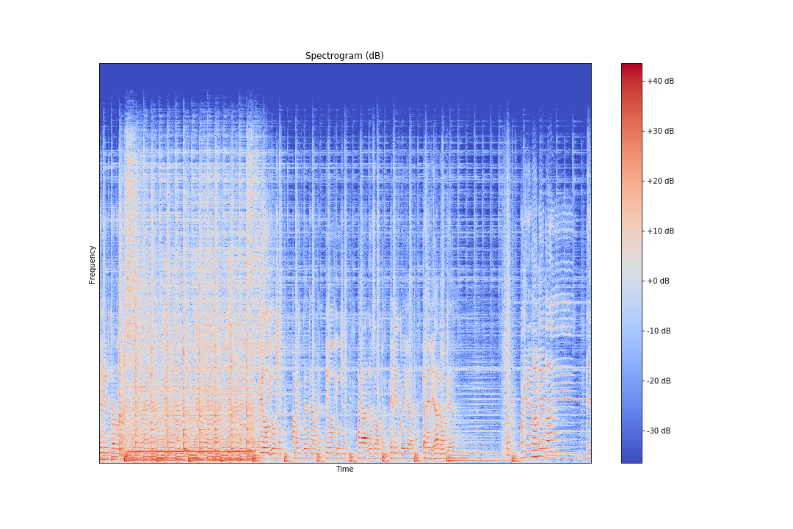
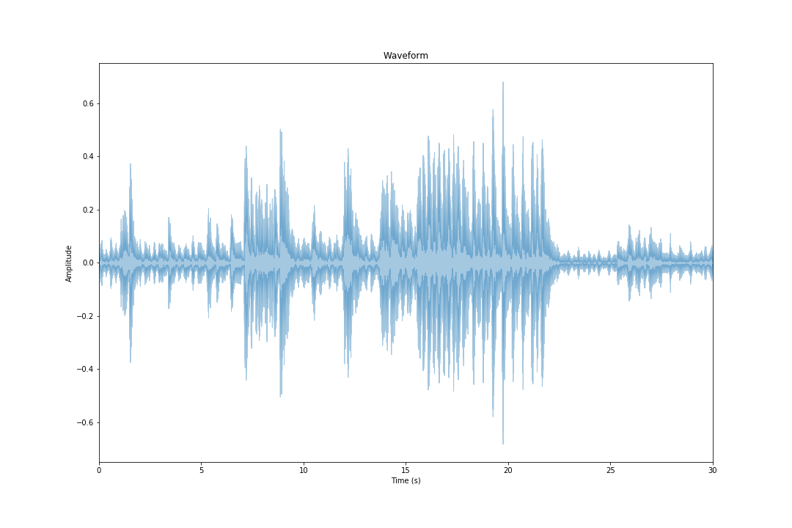
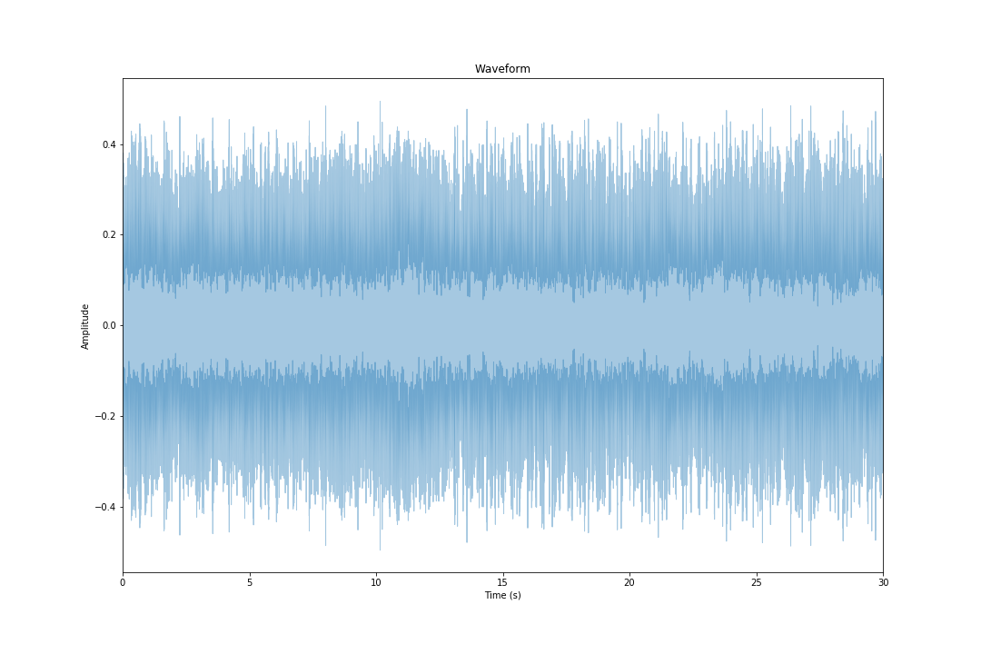
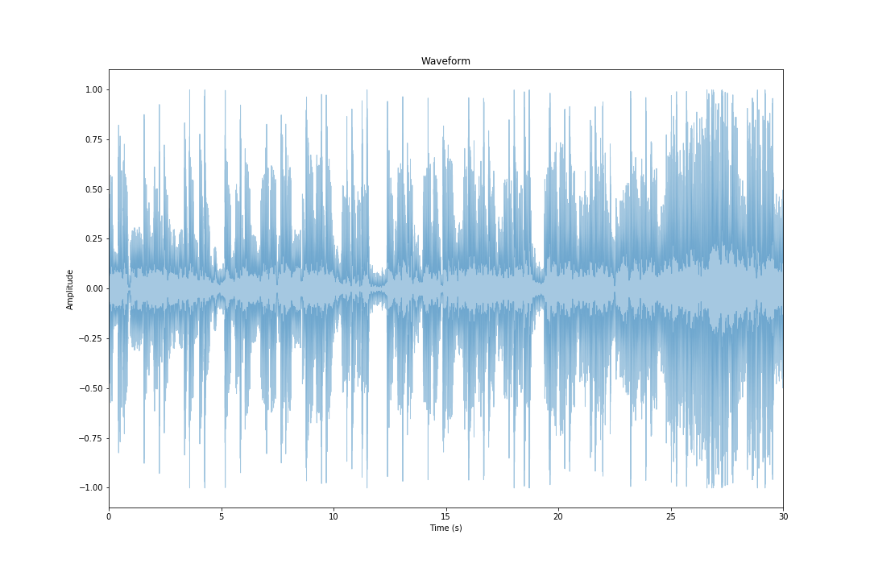
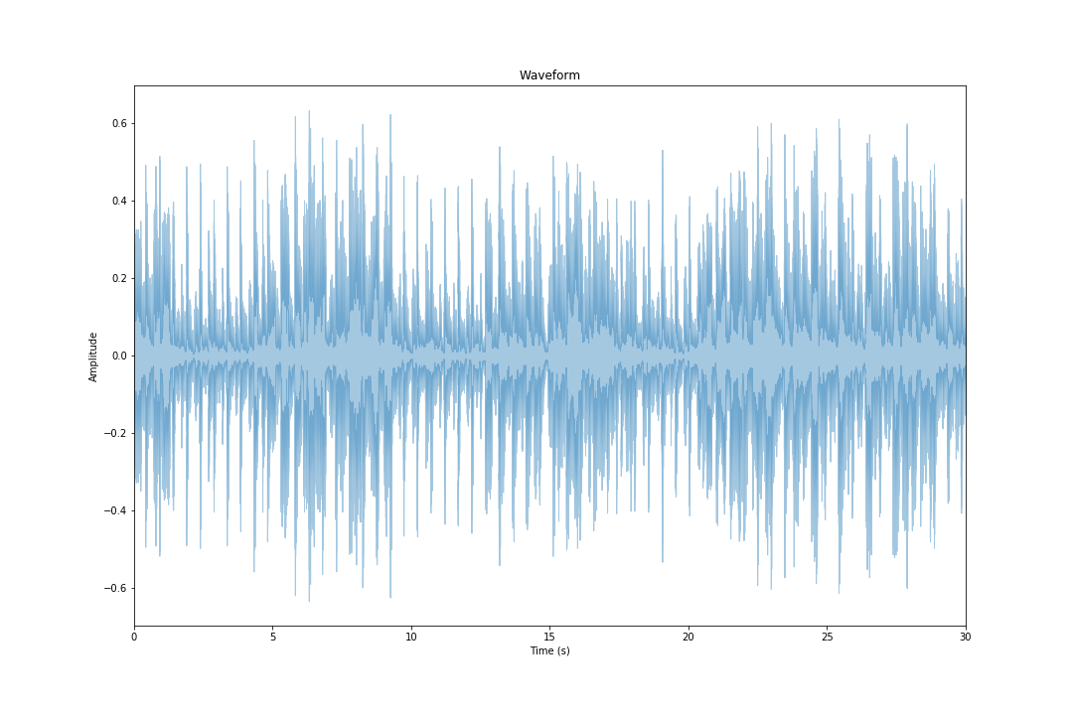
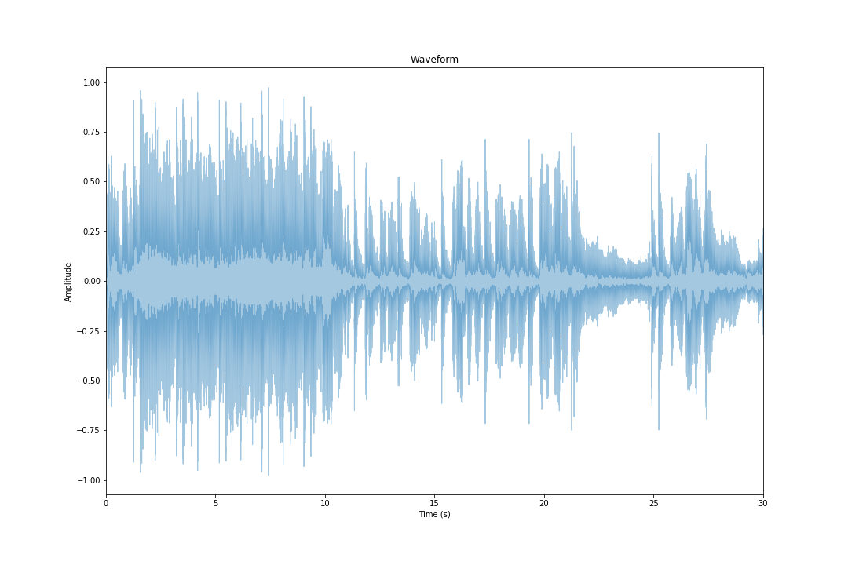
Blues
Classical
Country
Disco
Hip-Hop
Jazz
Metal
Pop
Reggae
Rock

Slide 6
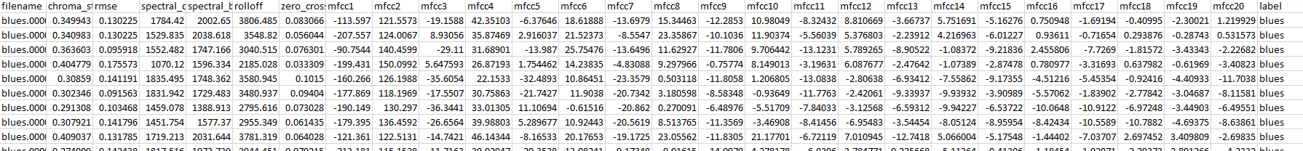
Filename
Chroma_stft –Short-time Fourier transform
Determine the sinusoidal frequency
Spectral_centroid
Spectral bandwith
Rolloff
The reduction of signal level as the frequency of the signals moves away from the cut-off frequency
Zero crossing rate
Rate of sign-changes along a signal
Mfcc {1-20} - Mel-Frequency Cepstral Coefficients
Describes the overall shape of a spectral envelope
Label – Our genres

Slide 7
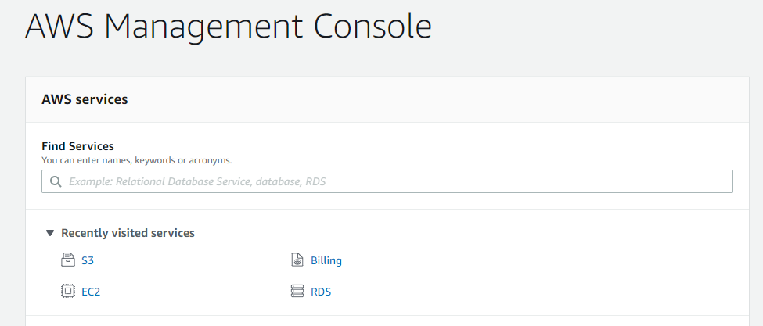
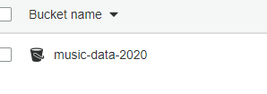
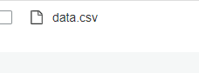
SHOW and TELL
Show casing Librosa
Converting Audio files to Spectrogram and Feature Data
Showing to code for spectral view - Ivan
Showing the code for Feature Relationship - Namitaa
Showing our Train and Test
Random Forest
KNN
Kmean
Converting new music to data - Ronald
Predicting the new music genre - Michael

Slide 8
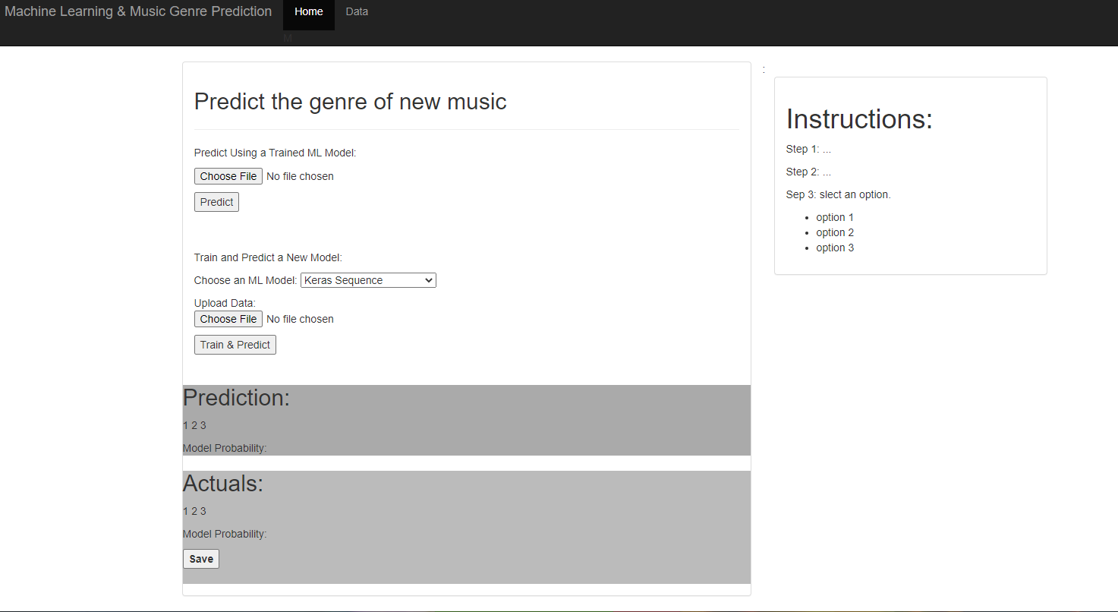
Conclusions & future work
There is no one model fits all:
KNN gave us the best results with 79% accuracy
Possible Areas to Boost Accuracy:
More samples may be the remedy or may not
Some genres are easier to predict than others
Future work:
Implement feature into UI
Test Deep Learning Models

Slide 9
Thank you!!! Questions??

